Slide 1
SMART WEATHER
WEATHER UPDATES MADE EASY

Slide 2
WEATHER APPS THESE DAYS
TURN ON WIFI/DATA
OPEN THE APP
POP UP ADS
TYPE THE ADDRESS
MORE ANNOYING ADS
WEATHER INFO

Slide 3
SYSTEM I DEVELOPED
Subscribe for Free using Text Messaging
Get Weather Info automatically every Morning
No Data Charges
No Ads
No Hassle

Slide 4
WHY NOT JUST USE APPS?
Not everyone is digitally literate
Data charges
Storage issues
Annoying ads
Not everyone has a smartphone

Slide 5
MY TARGET AUDIENCE:
Lazy People
Smart People
Old People
People without Smartphone

Slide 6
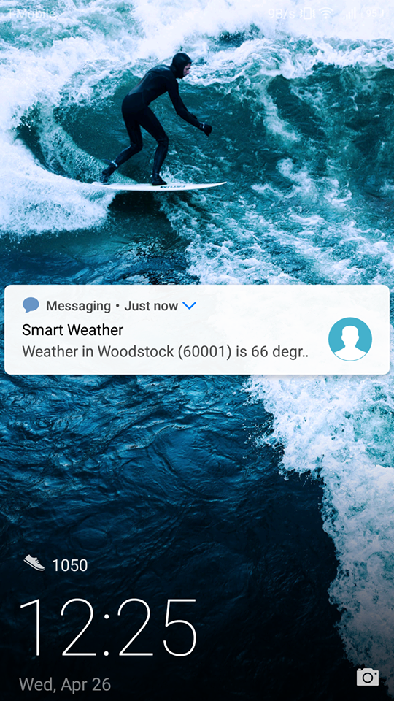
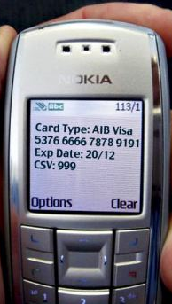
80%
20%
Weather in Mahwah (07430) is 66 degrees with clear sky.
Smart Phone
Basic Phone

Slide 7
COMMANDS
SUBSCRIBE
UNSUBSCRIBE
CURRENT WEATHER
START (Address)
STOP
NOW (Address)

Slide 8
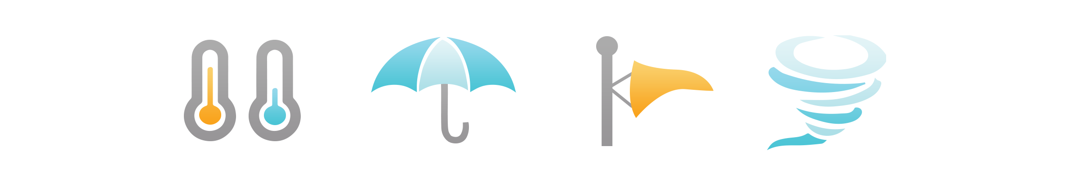
LETS TRY ONE
GET CURRENT WEATHER INFO OF
NEW YORK WITH ZIPCODE 10020
TEXT “NOW 60001” to 571-317-2222

Slide 9



TECHNOLOGIES USED
Node.js Server
Twilio for SMS Communication
Open Weather Map API for Weather Data
Currently hosted in my laptop exposing port using “ngrok”

Slide 10
FUTURE PLAN
Use more phone numbers/multiple weather APIs to handle higher volume of subscription.
Allow users to subscribe weekly forecast, weather advisories etc.
Advertise extensively on social media, google ads to gain more subscribers.
Generate revenue by allowing companies to sponsor the text messages.
Weather in Mahwah (07430) is 66 degrees with clear sky. Maximum Temp: 78
Minimum Temp: 56
----- Weather Info sponsored by NY Pizza and Pasta, Ramsey, NJ (Now offering delivery options)
Weather Info
No Annoying Ads

Slide 11
QUESTIONS?
Thank You!

